Slide 1


To investigate the use of Silicon Carbide MOSFET
BY
TALHA TALLAT | D18124645

Slide 2

What is SIC
Silicon Si + Carbon C = Silicon Carbide SiC
The crystalline structure of Silicon Carbide
Each atom is bonded to 4 atoms
Strong covalent bonding
https://www.researchgate.net/figure/Crystalline-structure-of-Silicon-Carbide_fig10_284725682

Slide 3

Introduction to Silicon Carbide SiC
Switch at higher frequencies and improve efficiency
higher power density
Hardest synthetic material
High conductivity with High-temperature strength up to 400 ˚C
Lower overall system cost
reduced cooling requirements
https://www.powerelectronicsnews.com/improving-energy-efficiency-in-industrial-applications-with-silicon-carbide/

Slide 4
Why SIC is important?
Demand for EVs is rising.
EV has the main motor that powers the wheels. Six power transistors and diodes are deployed to turn the motor.
Each transistor blocks 700V and switches a few hundred amps.
SiC in MOSFETs can help drive the electric vehicle’s motor with less power.

Slide 5
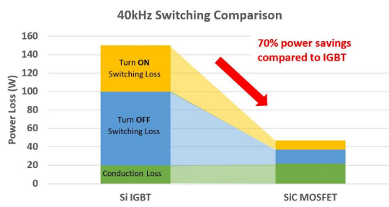
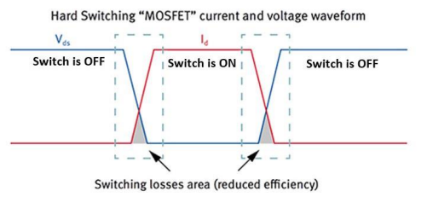

Switching losses
The combination of better switching performance, low $l_{on}$ resistance and high breakdown voltage make SiC devices ideal alternatives to traditional Si power MOSFETs

Slide 6
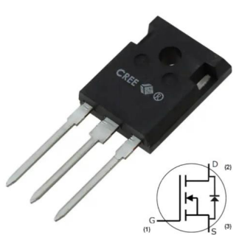
SiC MOSFET
Heat can transfer more effectively due to the wide bandgap
Fast-switching speeds
lighter systems that makes them more efficient

Slide 7
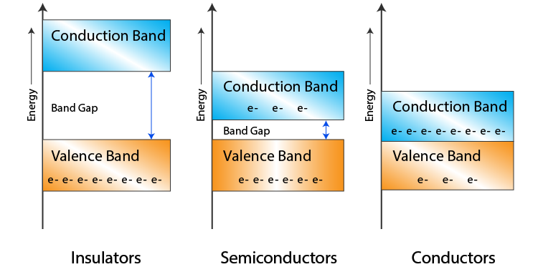
Bandgap
Gap increases, more energy is required to transfer the electronics from VB to CB
Low energy orbital to high energy

Slide 8
Implementing
Design & program a microcontroller circuit
1
Construct a Gate Driver circuit
2
Design a SIC MOSFET circuit
3
Test with 500 Hz frequencies
Test with higher frequencies up to 100KHz while switching +30 volts to +240V DC.

Slide 9
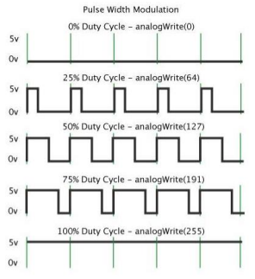
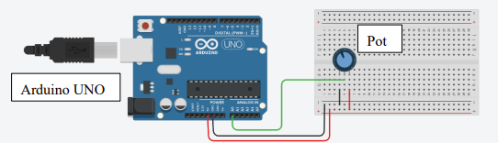
Producing PWM
PWM frequency for digital pin 9 is set to 490.20 Hz by default
Register is forced to produce 31 kHz

Slide 10
Arduino UNO Program
int pot = A0; // Assigning "pot" variable to the analog input pin A0 with type integer
int pinOut = 9; // Assigning "pinOut" variable to the digital output 9 with type integer
void setup() { // setup code run once:
Serial.begin(9600); // starts the seriral monitor at 9600 bot rate
pinMode(pinOut, OUTPUT);// pin 9 is declared as a ouput
pinMode(A0, INPUT); //pot
}
void loop() { //run continousily
int readPotValues = analogRead(pot); /*reads the pot 10-bit values and stores it to the "readPotValues" variable*/
int dutyCycle = (255./1023.) * readPotValues; /* conversion from reading analog 10-bit (0-1023) to 8-bit (0-255) scale*/
analogWrite (pinOut, dutyCycle); /* write a 8-bit stored values in "dutyCycle" to the output pin 9 */
Serial.print("Analog Value to the Output"); /* print "Analog Value to the Output" in serial monitor*/
Serial.print (x); // prints the output to the serial monitor
delay (500); // addes half a minute delay
}

Slide 11
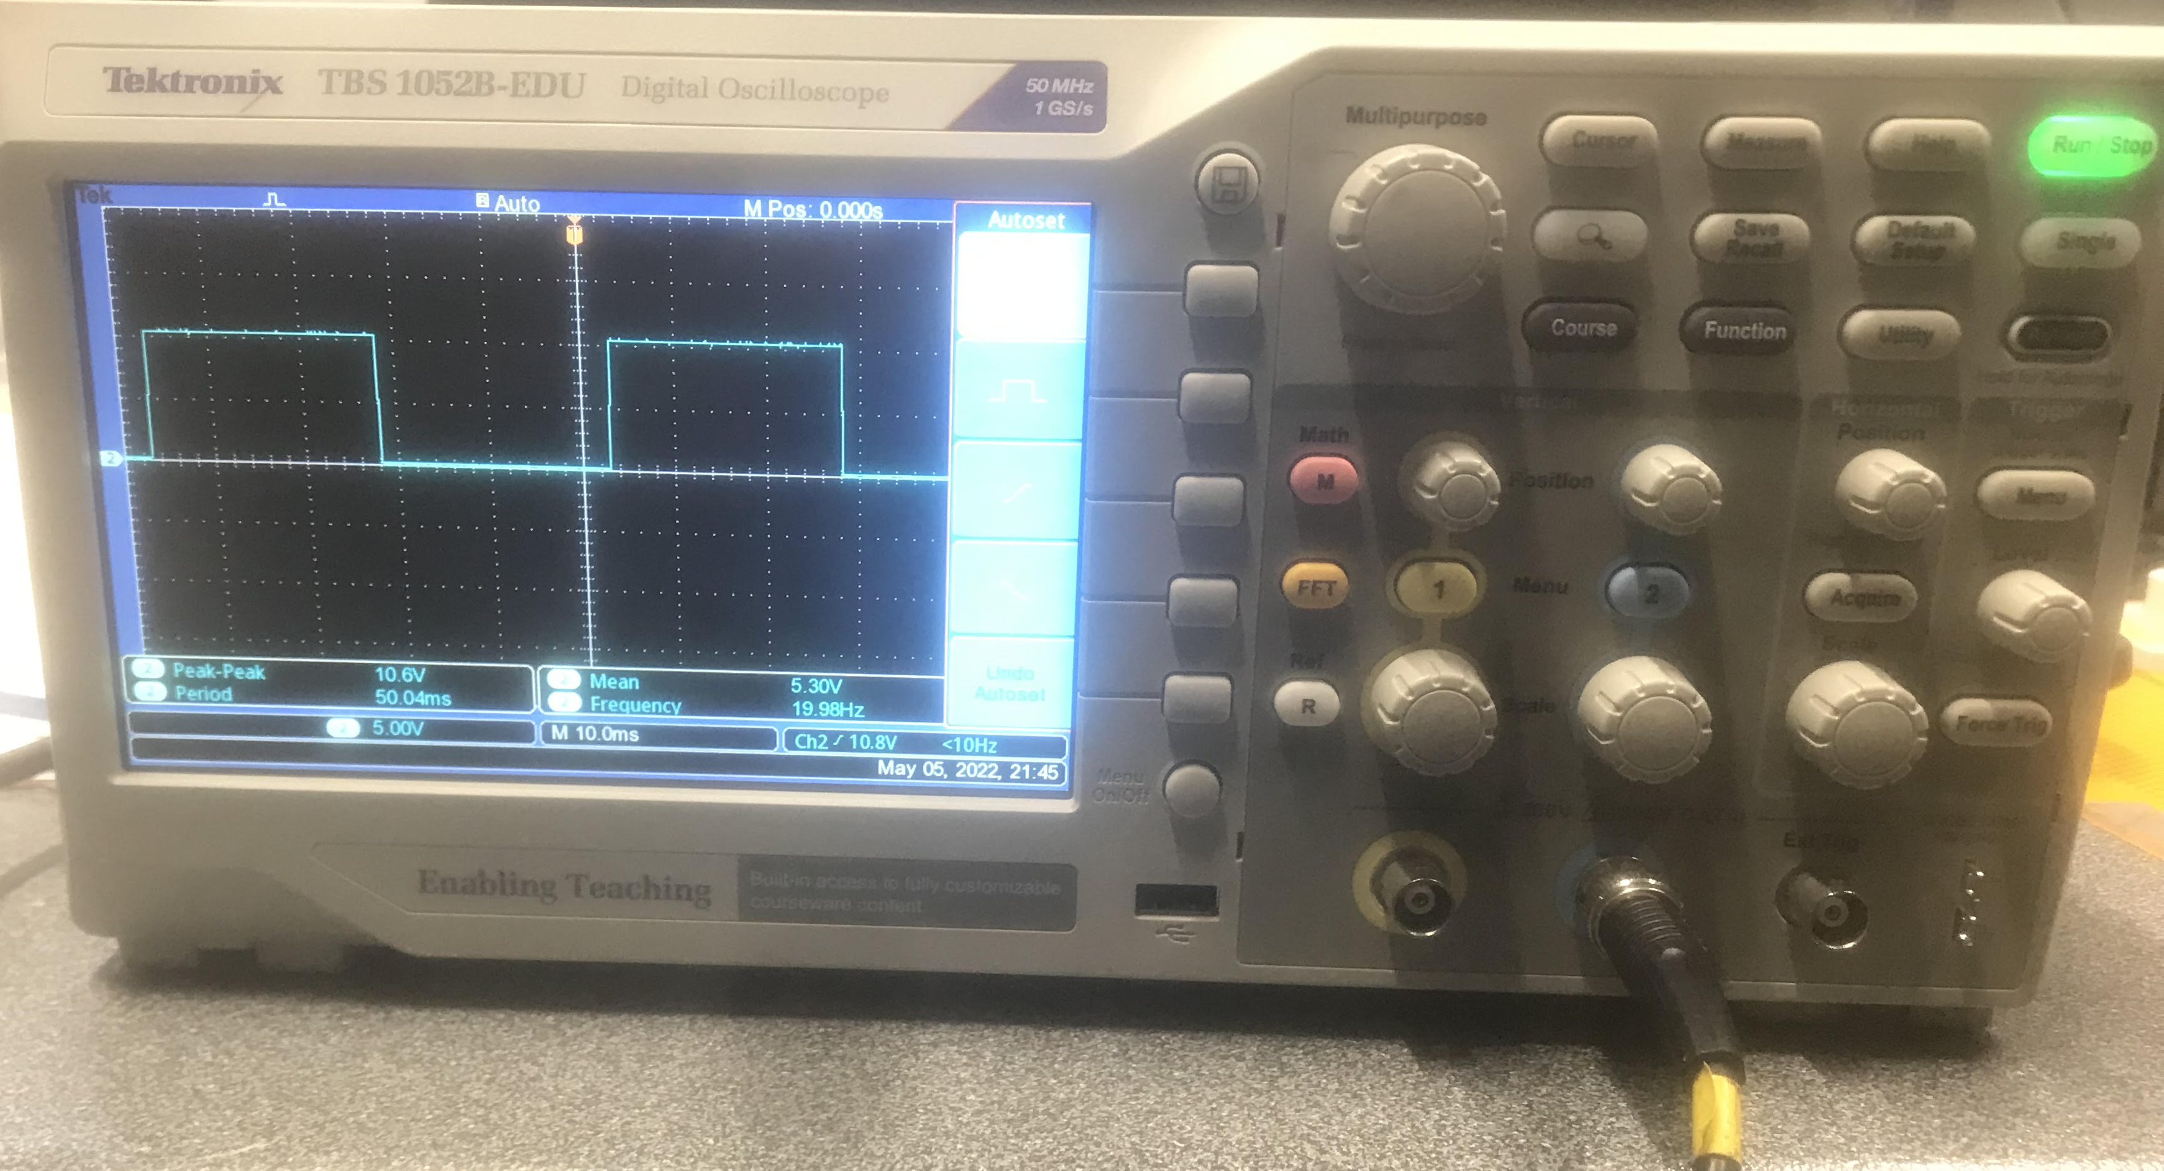
Result of the PWM
Frequency set at 20 Hz
Vp: 5V
20mA

Slide 12
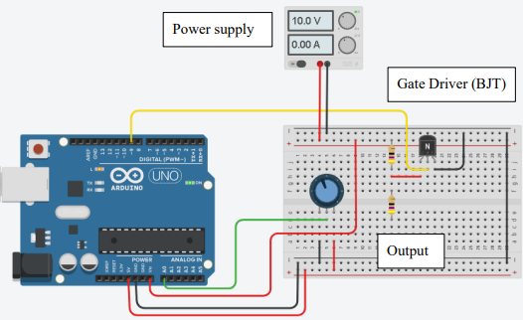
Gate Driver
V = 10𝑣 𝑅 = 47 𝑜ℎ𝑚𝑠
𝐼 = 𝑉/𝑅 = 10/47
= 212𝑚𝐴
𝑃 = 𝐼^2 𝑅
𝑃 = (212 ∗ 10^−3 ) ^2 (47)
𝑃 = 2.11 Watts

Slide 13
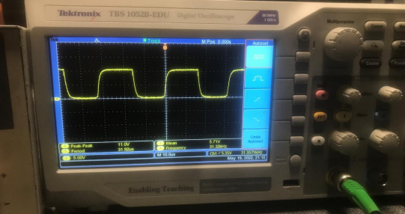
Results of the Gate driver at a high frequency

Slide 14
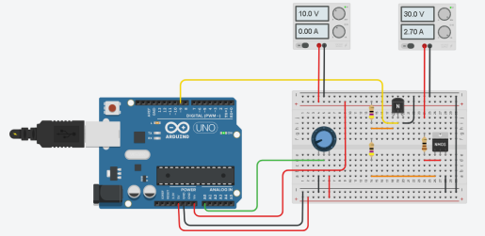
SiC MOSFET Circuit Development

Slide 15
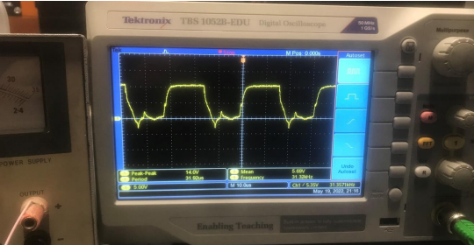
Result of the full system developed

Slide 16
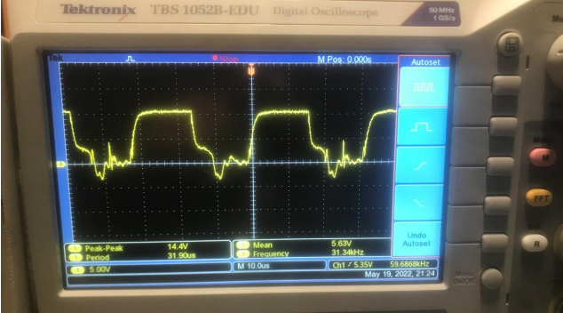
Results of high frequency at 220V DC

Slide 17
Conclusion
Ammeter was not measuring correct current values because is rated for 50 Hz AC and can't handle high frequencies therefore the ammeter readings were not trusted.
Oscilloscope common ground affects the common ground of the Circuit design. Therefore, took out the common, and ran the test.

